Slide 1



Pink for Princesses, Blue for superheroes:
The Need to Examine Gender Stereotypes in Kids’ Products in Search and Recommendations
Amifa Raj
People and Information Research Team, Boise State University
Ashlee Milton
People and Information Research Team, Boise State University
Michael D. Ekstrand
People and Information Research Team, Boise State University
Awards 17-51278, 19-30464

Slide 2
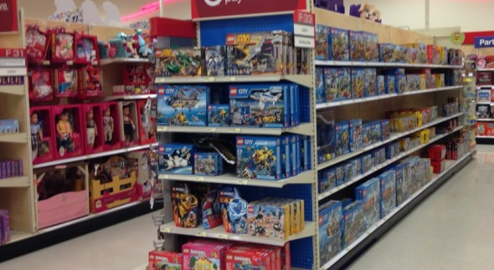
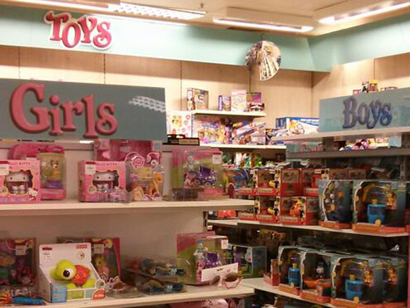
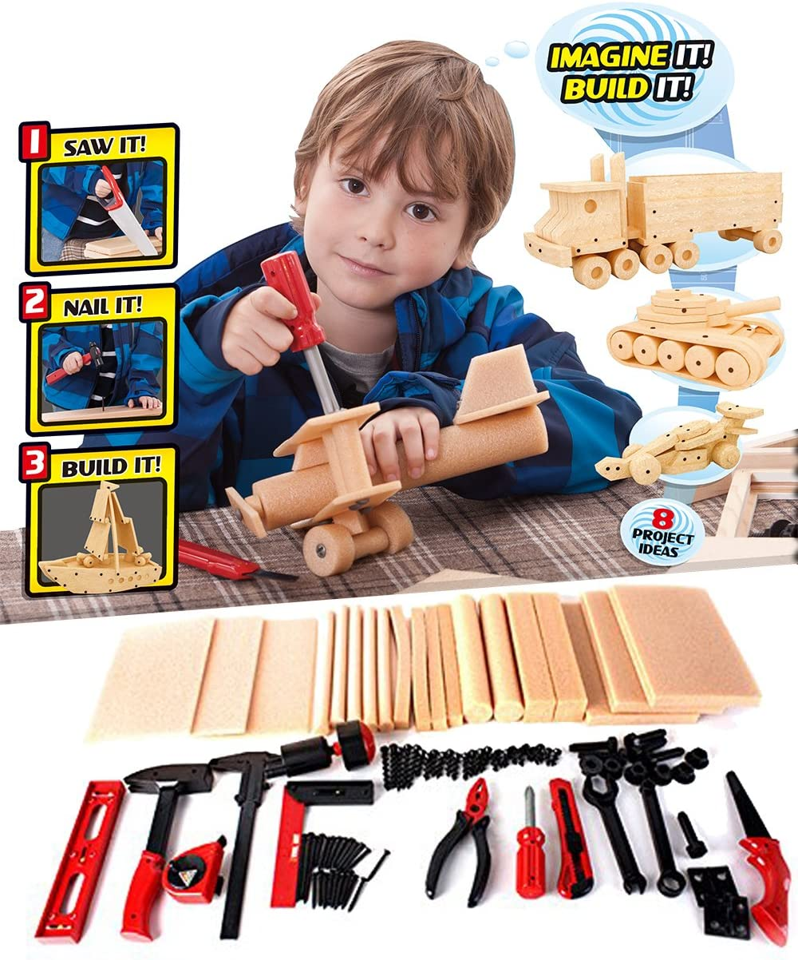
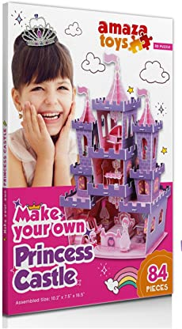
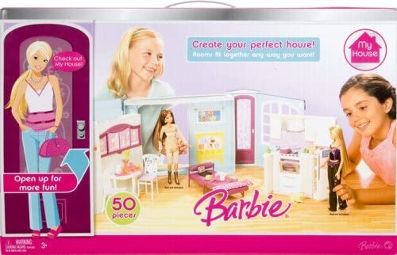
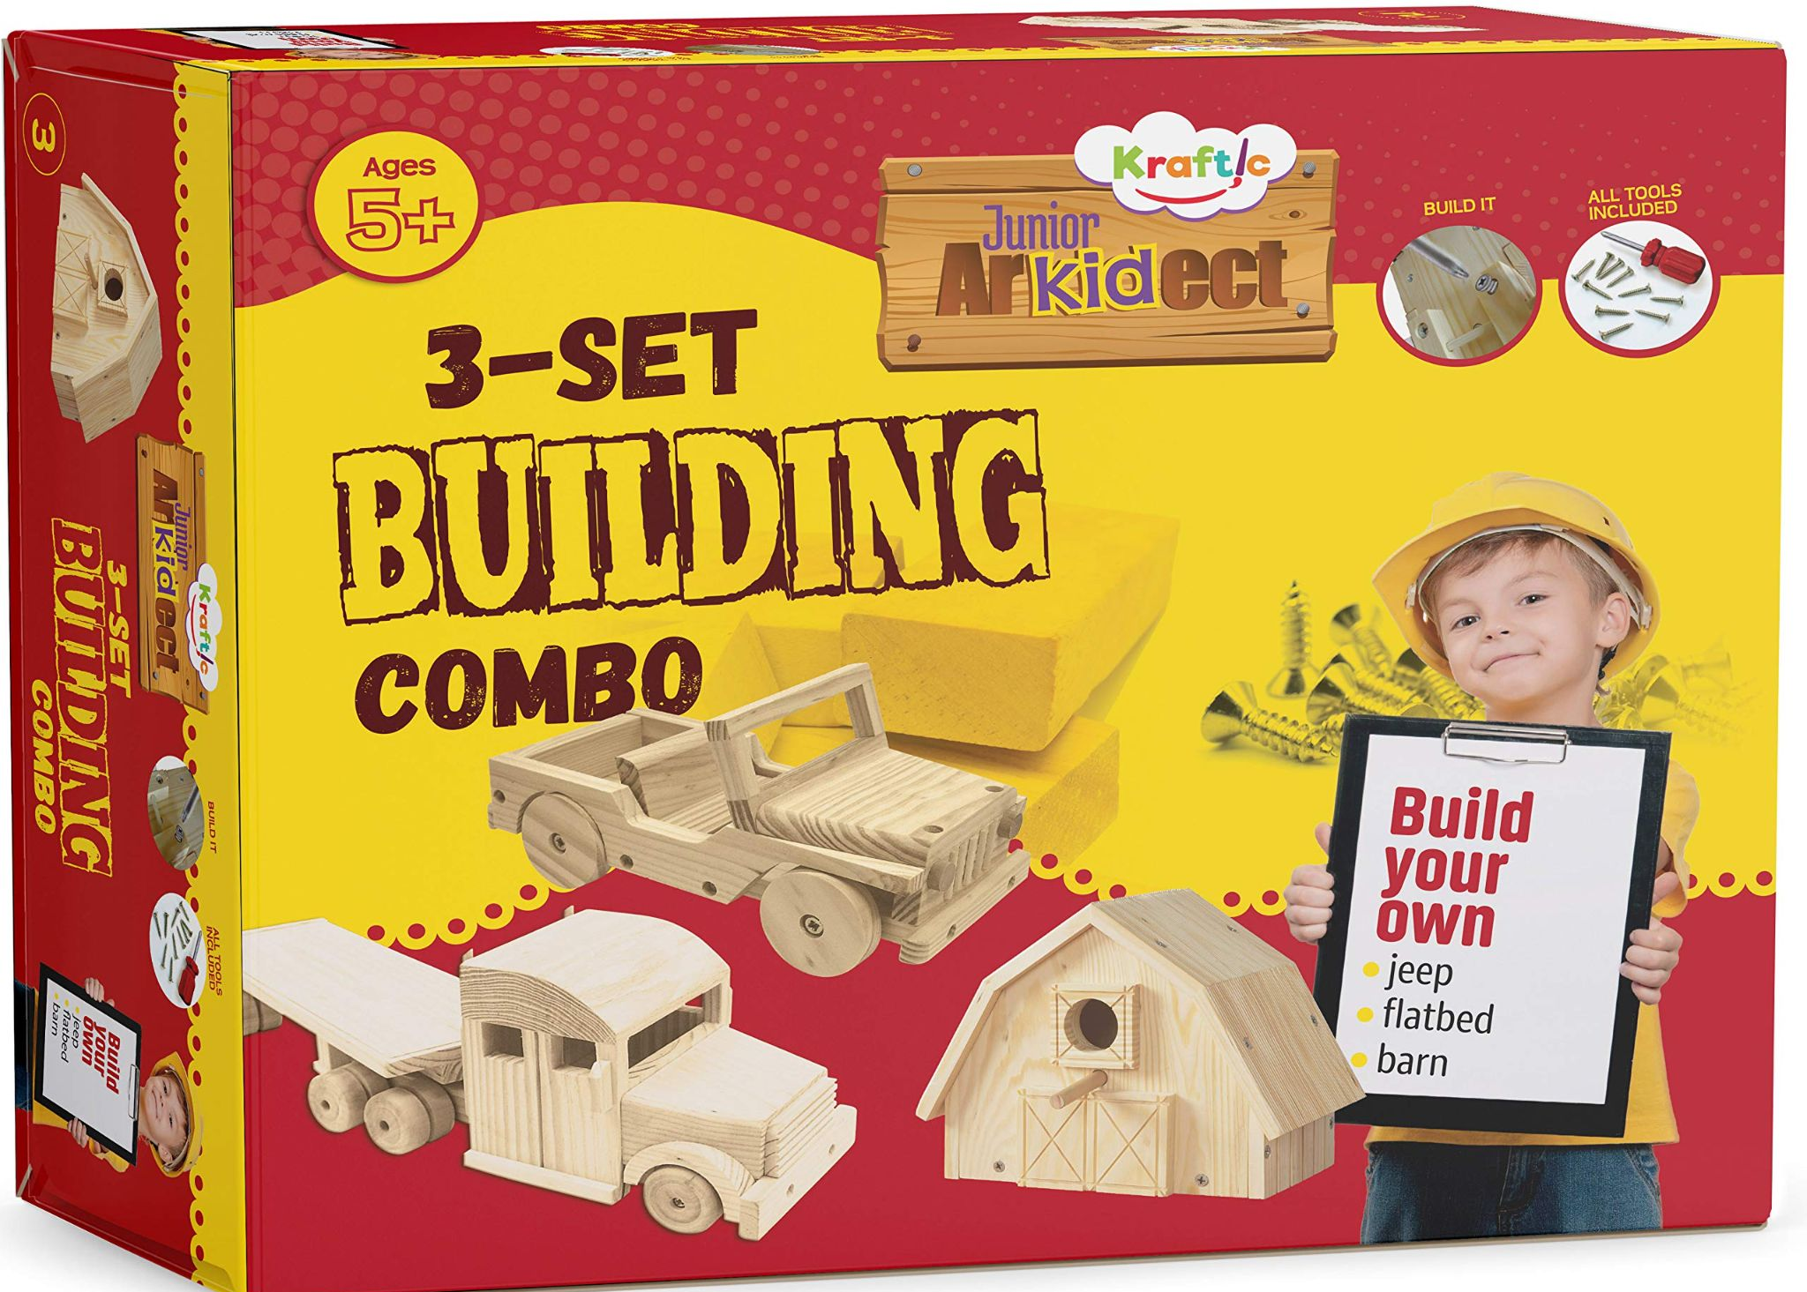
https://sociologyinfocus.com/target-toys-and-gender-how-much-do-words-matter-2/
https://www.lettoysbetoys.org.uk/thats-for-girls-and-thats-for-boys/

Slide 3
Gender stereotypes are common beliefs and social expectations associated with specific genders
Naomi Ellemers. 2018. Gender stereotypes. Annual review of psychology 69 (2018), 275–298

Slide 4
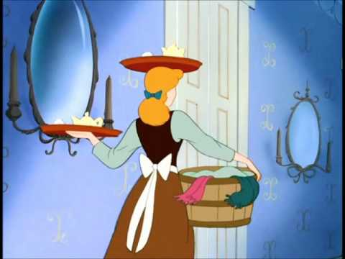
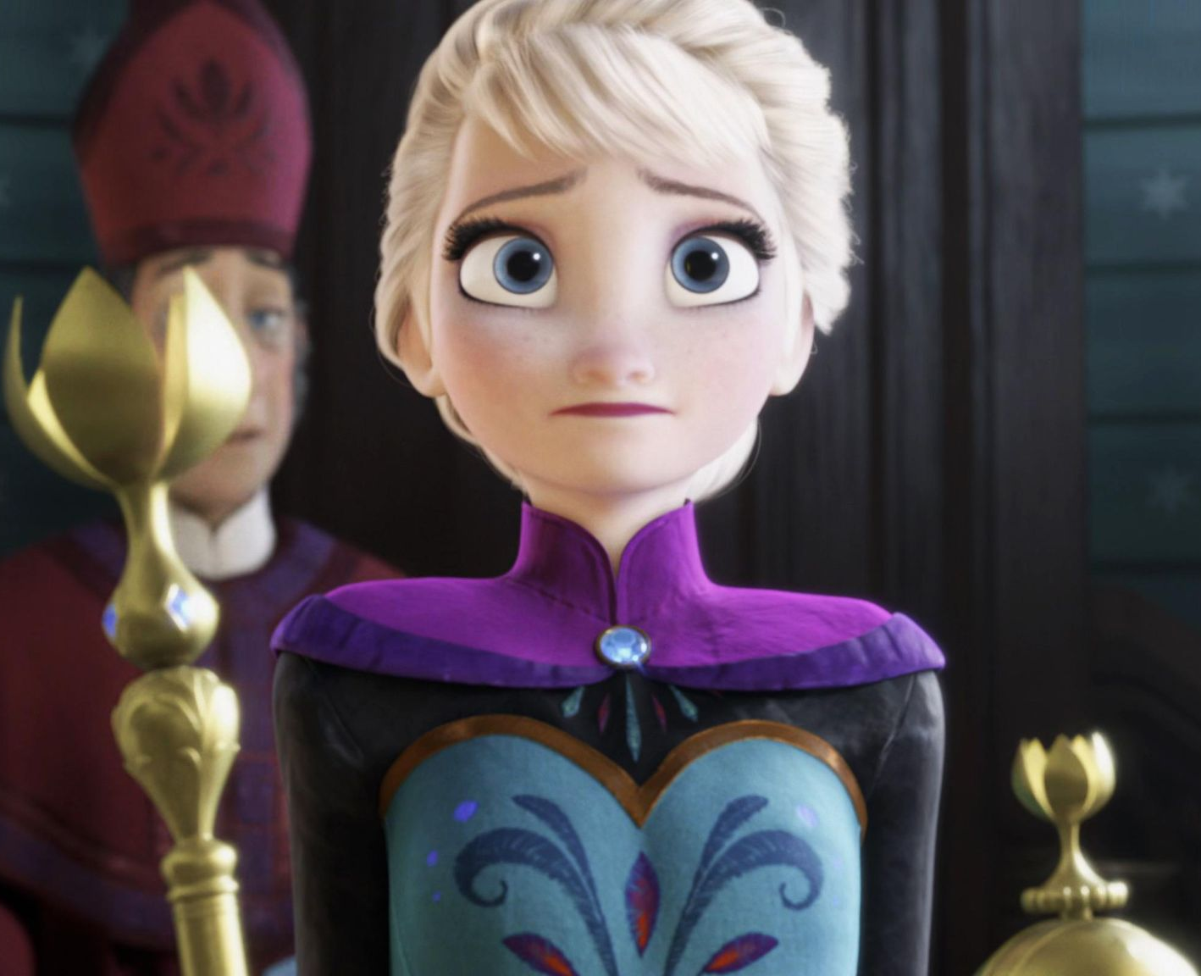
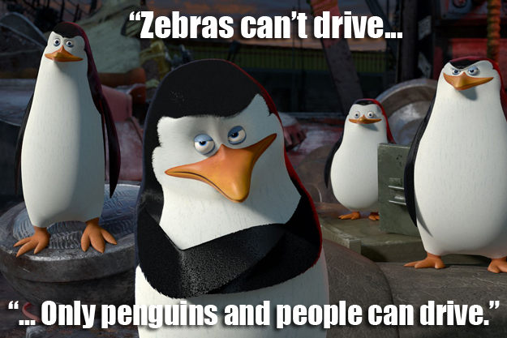
Impact of early childhood exposure of gender stereotypes
Gender Roles
Behavioral norm
Skills

Slide 5
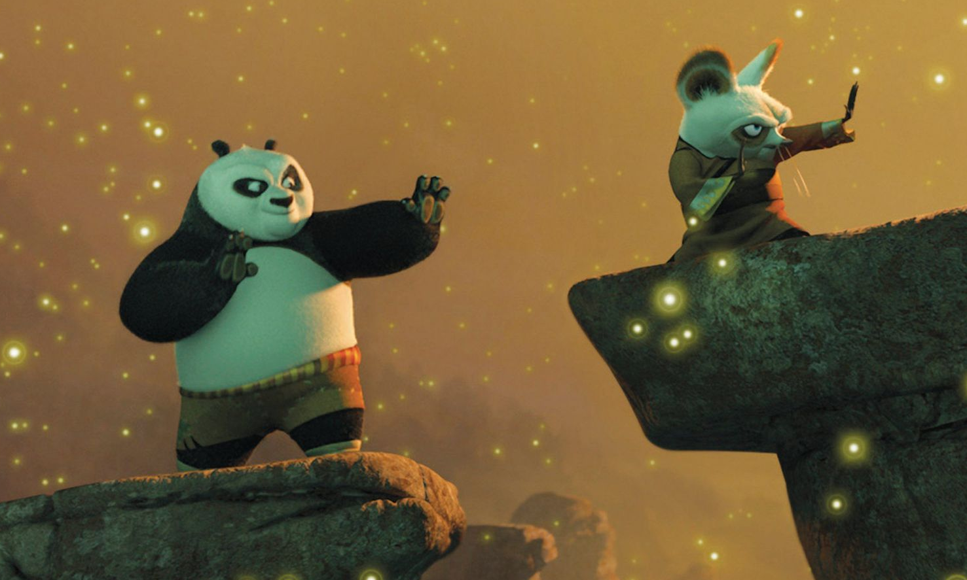
Gender Stereotypes in Classroom settings
Teachers have roles to play
Perspective
Aware of gender stereotypes
Take measure to fight stereotypes
Practice gender equity in their classrooms

Slide 6


Are we missing something?

Slide 7


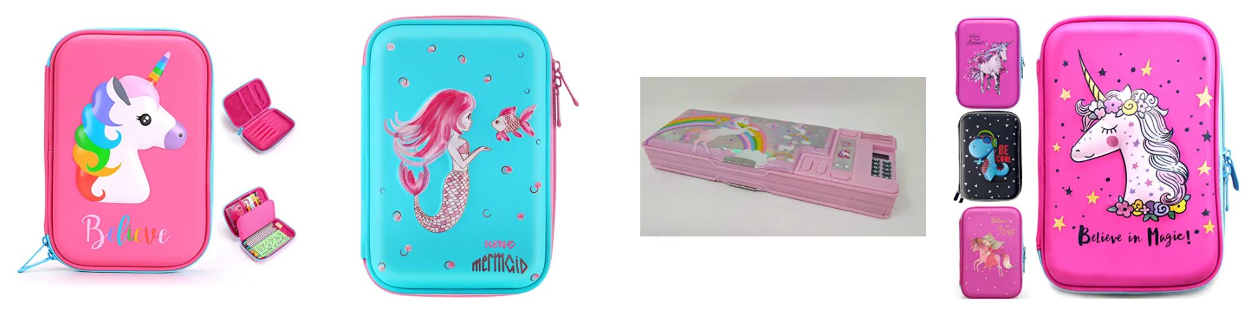
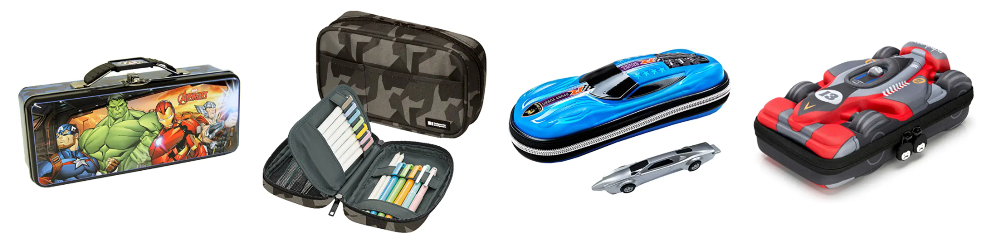
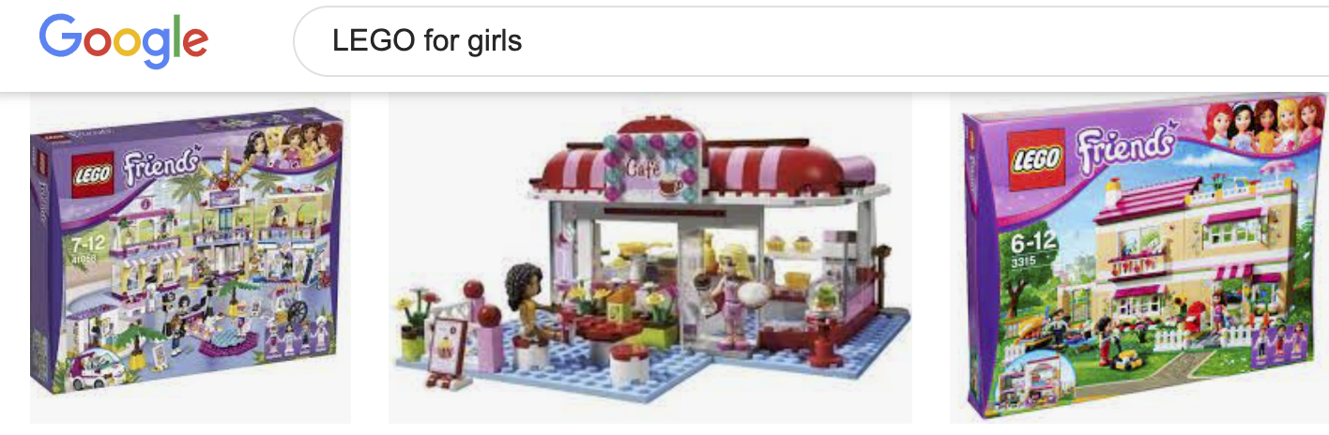
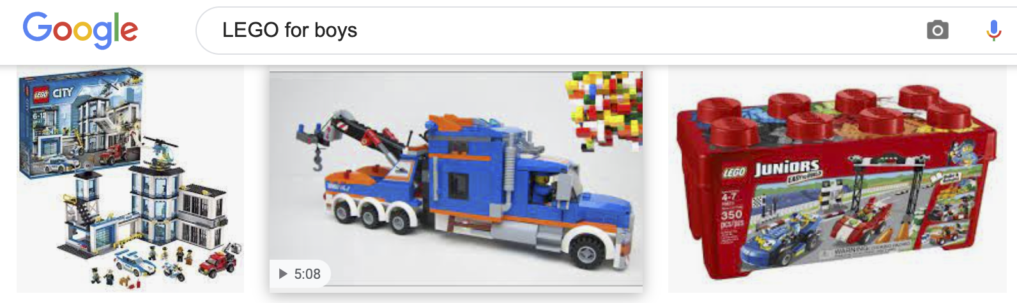
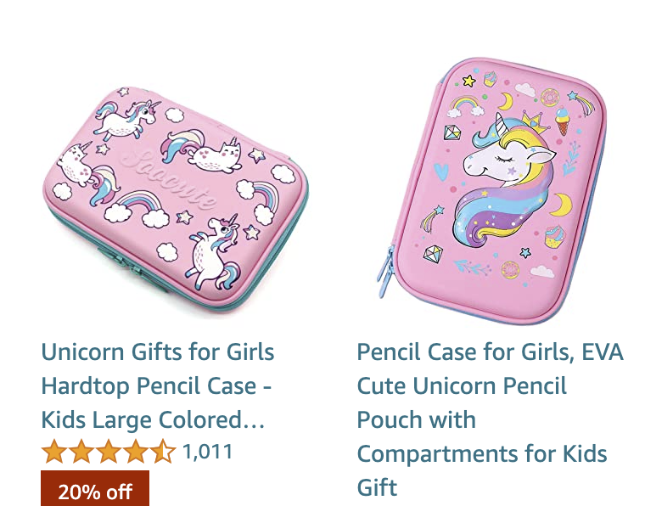
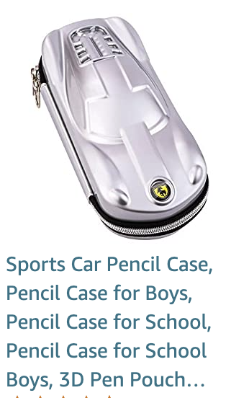

“Mermaid pencil box” related item recommendations
“Spiderman pencil box” related item recommendations

Slide 8
Research community needs to consider and address the possibility of search and recommendation systems reinforcing and propagating unnecessary gender stereotypes to children.

Slide 9
Research agenda
measurement
01.
Measure the presence
cause
02.
Identify the sources
impact
03.
Effect on both children and teachers
Mitigation
04.
Eliminate gender stereotypes

Slide 10
measurement
cause
(1) Detect gender stereotypes in search and recommendation results
(2) Data to help quantify
(3) Metric to measure
(1) Item descriptions
(2) User feedback
(3) Language model
(4) ...
Impact
Mitigation
(1) Impact of early childhood exposure of gender stereotypes through search and recommendations on:
Learning environment
Children behavior
Teachers who practice gender equity
(2) Distinguish the impact from parents and society
(1) Design goals
(2) Input data
(3) Algorithms
(4) Teacher’s expectations from systems
(5) Teachers’ role

Slide 11
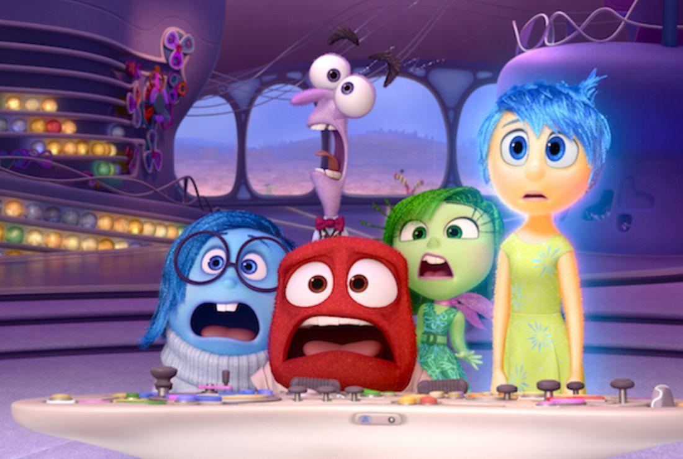
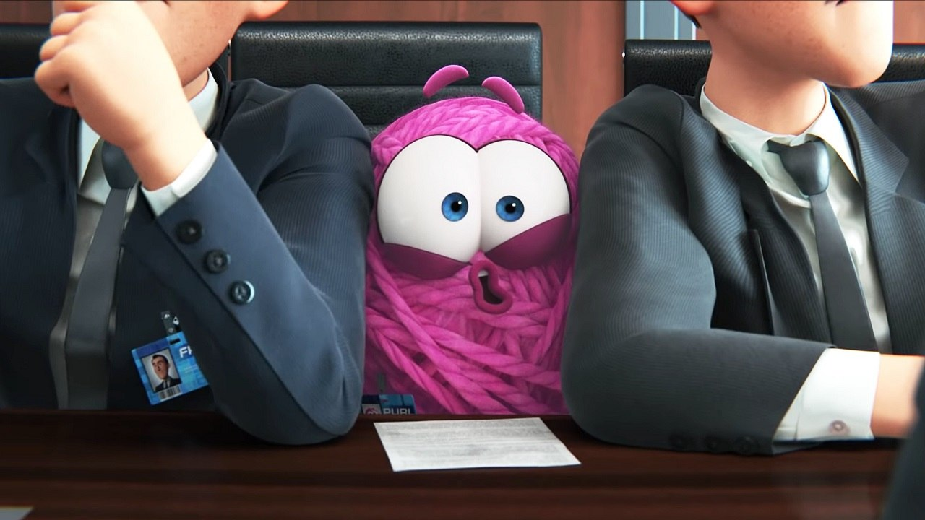
Bias and Fairness in Recommender systems
IR for Children

Slide 12
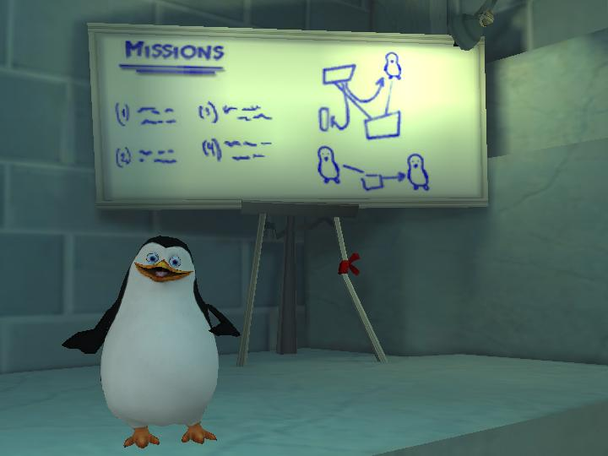

Summary
Need to investigate if and how gender stereotypes manifest in search and recommender systems
Proposed potential research direction (measure, cause, impact, mitigate)

Slide 13
thanks!
Real change, enduring change, happens one step at a time.
Ruth Bader Ginsburg

Slide 14
measurement
cause
(1) Detect gender stereotypes in search and recommendation results
(2) Data to help quantify
(3) Metric to measure
(1) Item descriptions
(2) User feedback
(3) Language model
(4) ...
Impact
Mitigation
(1) Impact of early childhood exposure of gender stereotypes through search and recommendations on:
Learning environment
Children behavior
Teachers who practice gender equity
(2) Distinguish the impact from parents and society
(1) Design goals
(2) Input data
(3) Algorithms
(4) Teacher’s expectations from systems
(5) Teachers’ role

